Slide 1


UNIT 7
Quality Assurance and Management

Slide 2


Content
Quality Concepts and Software Quality Assurance
Software Reviews (Formal Technical Reviews)
Software Reliability
The Quality Standards: ISO 9000, CMM, Six Sigma for SE
SQA Plan
Unit 7

Slide 3
Quality Concepts
In 2005, ComputerWorld [Hil05] lamented that
“bad software plagues nearly every organization that uses computers, causing lost work hours during computer downtime, lost or corrupted data, missed sales opportunities, high IT support and maintenance costs, and low customer satisfaction.
A year later, InfoWorld [Fos06] wrote about the
“the sorry state of software quality” reporting that the quality problem had not gotten any better.
Today, software quality remains an issue, but who is to blame?
Customers blame developers, arguing that sloppy practices lead to low-quality software.
Developers blame customers (and other stakeholders), arguing that irrational delivery dates and a continuing stream of changes force them to deliver software before it has been fully validated.
Unit 7

Slide 4
Quality
The American Heritage Dictionary defines quality as
“a characteristic or attribute of something.”
For software, two kinds of quality may be encountered:
Quality of design encompasses requirements, specifications, and the design of the system.
Quality of conformance is an issue focused primarily on implementation.
User satisfaction = compliant product + good quality + delivery within budget and schedule
Unit 7

Slide 5
Quality—A Philosophical View
Robert Persig [Per74] commented on the thing we call quality:
Quality . . . you know what it is, yet you don't know what it is. But that's self-contradictory. But some things are better than others, that is, they have more quality. But when you try to say what the quality is, apart from the things that have it, it all goes poof! There's nothing to talk about. But if you can't say what Quality is, how do you know what it is, or how do you know that it even exists? If no one knows what it is, then for all practical purposes it doesn't exist at all. But for all practical purposes it really does exist. What else are the grades based on? Why else would people pay fortunes for some things and throw others in the trash pile? Obviously some things are better than others . . . but what's the betterness? . . . So round and round you go, spinning mental wheels and nowhere finding anyplace to get traction. What the hell is Quality? What is it?
Unit 7

Slide 6
Quality—A Pragmatic View
The transcendental view argues (like Persig) that quality is something that you immediately recognize, but cannot explicitly define.
The user view sees quality in terms of an end-user’s specific goals. If a product meets those goals, it exhibits quality.
The manufacturer’s view defines quality in terms of the original specification of the product. If the product conforms to the spec, it exhibits quality.
The product view suggests that quality can be tied to inherent characteristics (e.g., functions and features) of a product.
Finally, the value-based view measures quality based on how much a customer is willing to pay for a product. In reality, quality encompasses all of these views and more.
Unit 7

Slide 7
Software Quality
Software quality can be defined as:
An effective software process applied in a manner that creates a useful product that provides measurable value for those who produce it and those who use it.
This definition has been adapted from [Bes04] and replaces a more manufacturing-oriented view presented in earlier editions of this book.
Unit 7

Slide 8
Effective Software Process
An effective software process establishes the infrastructure that supports any effort at building a high quality software product.
The management aspects of process create the checks and balances that help avoid project chaos—a key contributor to poor quality.
Software engineering practices allow the developer to analyze the problem and design a solid solution—both critical to building high quality software.
Finally, umbrella activities such as change management and technical reviews have as much to do with quality as any other part of software engineering practice.
Unit 7

Slide 9
Useful Product
A useful product delivers the content, functions, and features that the end-user desires
But as important, it delivers these assets in a reliable, error free way.
A useful product always satisfies those requirements that have been explicitly stated by stakeholders.
In addition, it satisfies a set of implicit requirements (e.g., ease of use) that are expected of all high quality software.
Unit 7

Slide 10
Adding Value
By adding value for both the producer and user of a software product, high quality software provides benefits for the software organization and the end-user community.
The software organization gains added value because high quality software requires less maintenance effort, fewer bug fixes, and reduced customer support.
The user community gains added value because the application provides a useful capability in a way that expedites some business process.
The end result is:
(1) greater software product revenue,
(2) better profitability when an application supports a business process, and/or
(3) improved availability of information that is crucial for the business.
Unit 7

Slide 11
Quality Dimensions
David Garvin [Gar87]:
Performance Quality. Does the software deliver all content, functions, and features that are specified as part of the requirements model in a way that provides value to the end-user?
Feature quality. Does the software provide features that surprise and delight first-time end-users?
Reliability. Does the software deliver all features and capability without failure? Is it available when it is needed? Does it deliver functionality that is error free?
Conformance. Does the software conform to local and external software standards that are relevant to the application? Does it conform to de facto design and coding conventions? For example, does the user interface conform to accepted design rules for menu selection or data input?
Unit 7

Slide 12
Contd…
Durability. Can the software be maintained (changed) or corrected (debugged) without the inadvertent generation of unintended side effects? Will changes cause the error rate or reliability to degrade with time?
Serviceability. Can the software be maintained (changed) or corrected (debugged) in an acceptably short time period. Can support staff acquire all information they need to make changes or correct defects?
Aesthetics. Most of us would agree that an aesthetic entity has a certain elegance, a unique flow, and an obvious “presence” that are hard to quantify but evident nonetheless.
Perception. In some situations, you have a set of prejudices that will influence your perception of quality.
Unit 7

Slide 13
Other Views
McCall’s Quality Factors
ISO 9126 Quality Factors
Targeted Factors
Unit 7

Slide 14
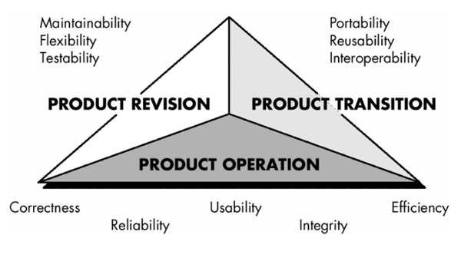
McCall’s Quality Factors
Unit 7

Slide 15
ISO 9126 Quality Factors
6 quality attributes:
Reliability : Once a software system is functioning, as specified, and delivered the reliability characteristic defines the capability of the system to maintain its service provision under defined conditions for defined periods of time. One aspect of this characteristic is fault tolerance that is the ability of a system to withstand component failure. For example if the network goes down for 20 seconds then comes back the system should be able to recover and continue functioning. Usability : Usability only exists with regard to functionality and refers to the ease of use for a given function. The ability to learn how to use a system (learnability) is also a major sub-characteristic of usability. Efficiency : This characteristic is concerned with the system resources used when providing the required functionality. The amount of disk space, memory, network etc. provides a good indication of this characteristic. As with a number of these characteristics, there are overlaps. For example the usability of a system is influenced by the system's Performance, in that if a system takes 3 hours to respond the system would not be easy to use although the essential issue is a performance or efficiency characteristic.
Unit 7

Slide 16
Maintainability : The ability to identify and fix a fault within a software component is what the maintainability characteristic addresses. In other software quality models this characteristic is referenced as supportability. Maintainability is impacted by code readability or complexity as well as modularization. Anything that helps with identifying the cause of a fault and then fixing the fault is the concern of maintainability. Also the ability to verify (or test) a system, i.e. testability, is one of the subcharacteristics of maintainability. Portability : This characteristic refers to how well the software can adopt to changes in its environment or with its requirements. The sub-characteristics of this characteristic include adaptability. Object oriented design and implementation practices can contribute to the extent to which this characteristic is present in a given system.
Functionality: Functionality is the essential purpose of any product or service. The degree to which the software satisfies stated needs as indicated by the following subattributes – suitabillity, accuracy, interoperability, compliance and security
Unit 7

Slide 17
Targeted Quality Factors
Intuitiveness : degree to which the interface follows expected usage patterns so that even a novice can use it without significant training.
Efficiency : degree to which the operations and information can be located or initiated.
Robustness : degree to which the software handles bad input or inappropriate user interaction.
Richness : degree to which the interface provides a rich feature set.
Unit 7

Slide 18
The Software Quality Dilemma
If you produce a software system that has terrible quality, you lose because no one will want to buy it.
If on the other hand you spend infinite time, extremely large effort, and huge sums of money to build the absolutely perfect piece of software, then it's going to take so long to complete and it will be so expensive to produce that you'll be out of business anyway.
Either you missed the market window, or you simply exhausted all your resources.
So people in industry try to get to that magical middle ground where the product is good enough not to be rejected right away, such as during evaluation, but also not the object of so much perfectionism and so much work that it would take too long or cost too much to complete. [Ven03]
Unit 7

Slide 19
“Good Enough” Software
Good enough software delivers high quality functions and features that end-users desire, but at the same time it delivers other more obscure or specialized functions and features that contain known bugs.
Arguments against “good enough.”
It is true that “good enough” may work in some application domains and for a few major software companies. After all, if a company has a large marketing budget and can convince enough people to buy version 1.0, it has succeeded in locking them in.
If you work for a small company be wary of this philosophy. If you deliver a “good enough” (buggy) product, you risk permanent damage to your company’s reputation.
You may never get a chance to deliver version 2.0 because bad buzz may cause your sales to plummet and your company to fold.
If you work in certain application domains (e.g., real time embedded software, application software that is integrated with hardware can be negligent and open your company to expensive litigation.
Unit 7

Slide 20
Cost of Quality
Prevention costs include
quality planning
formal technical reviews
test equipment
Training
Internal failure costs include
rework
repair
failure mode analysis
External failure costs are
complaint resolution
product return and replacement
help line support
warranty work
Unit 7

Slide 21
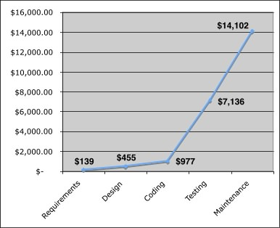
Cost
The relative costs to find and repair an error or defect increase dramatically as we go from prevention to detection to internal failure to external failure costs.
Unit 7

Slide 22
Quality and Risk
“People bet their jobs, their comforts, their safety, their entertainment, their decisions, and their very lives on computer software. It better be right.”
Example:
Throughout the month of November, 2000 at a hospital in Panama, 28 patients received massive overdoses of gamma rays during treatment for a variety of cancers. In the months that followed, five of these patients died from radiation poisoning and 15 others developed serious complications. What caused this tragedy? A software package, developed by a U.S. company, was modified by hospital technicians to compute modified doses of radiation for each patient.
Unit 7

Slide 23
Negligence and Liability
The story is all too common. A governmental or corporate entity hires a major software developer or consulting company to analyze requirements and then design and construct a software-based “system” to support some major activity.
The system might support a major corporate function (e.g., pension management) or some governmental function (e.g., healthcare administration or homeland security).
Work begins with the best of intentions on both sides, but by the time the system is delivered, things have gone bad.
The system is late, fails to deliver desired features and functions, is error-prone, and does not meet with customer approval.
Litigation ensues.
Unit 7

Slide 24
Quality and Security
Gary McGraw comments [Wil05]:
“Software security relates entirely and completely to quality. You must think about security, reliability, availability, dependability—at the beginning, in the design, architecture, test, and coding phases, all through the software life cycle [process]. Even people aware of the software security problem have focused on late life-cycle stuff. The earlier you find the software problem, the better. And there are two kinds of software problems. One is bugs, which are implementation problems. The other is software flaws—architectural problems in the design. People pay too much attention to bugs and not enough on flaws.”
Unit 7

Slide 25
Achieving Software Quality
Critical success factors:
Software Engineering Methods
Project Management Techniques
Quality Control
Quality Assurance
Unit 7

Slide 26
Software Quality Assurance
Elements of SQA:
Standards
Reviews and Audits
Testing
Error/defect collection and analysis
Change management
Education
Vendor management
Security management
Safety
Risk management
Unit 7

Slide 27
Role of the SQA Group-I
Prepares an SQA plan for a project.
The plan identifies
evaluations to be performed
audits and reviews to be performed
standards that are applicable to the project
procedures for error reporting and tracking
documents to be produced by the SQA group
amount of feedback provided to the software project team
Participates in the development of the project’s software process description.
The SQA group reviews the process description for compliance with organizational policy, internal software standards, externally imposed standards (e.g., ISO-9001), and other parts of the software project plan.
Unit 7

Slide 28
Contd…
Reviews software engineering activities to verify compliance with the defined software process.
identifies, documents, and tracks deviations from the process and verifies that corrections have been made.
Audits designated software work products to verify compliance with those defined as part of the software process.
reviews selected work products; identifies, documents, and tracks deviations; verifies that corrections have been made
periodically reports the results of its work to the project manager.
Ensures that deviations in software work and work products are documented and handled according to a documented procedure.
Records any noncompliance and reports to senior management.
Noncompliance items are tracked until they are resolved.
Unit 7

Slide 29
SQA Goals
Requirements quality. The correctness, completeness, and consistency of the requirements model will have a strong influence on the quality of all work products that follow.
Design quality. Every element of the design model should be assessed by the software team to ensure that it exhibits high quality and that the design itself conforms to requirements.
Code quality. Source code and related work products (e.g., other descriptive information) must conform to local coding standards and exhibit characteristics that will facilitate maintainability.
Quality control effectiveness. A software team should apply limited resources in a way that has the highest likelihood of achieving a high quality result.
Unit 7

Slide 30
Statistical SQA
Product
& Process
Collect information on all defects
Find the causes of the defects
Move to provide fixes for the process
measurement
... an understanding of how
to improve quality ...
Unit 7

Slide 31
Statistical SQA
Information about software errors and defects is collected and categorized.
An attempt is made to trace each error and defect to its underlying cause (e.g., non-conformance to specifications, design error, violation of standards, poor communication with the customer).
Using the Pareto principle (80 percent of the defects can be traced to 20 percent of all possible causes), isolate the 20 percent (the vital few).
Once the vital few causes have been identified, move to correct the problems that have caused the errors and defects.
Unit 7

Slide 32
What Are Reviews?
a meeting conducted by technical people for technical people
a technical assessment of a work product created during the software engineering process
a software quality assurance mechanism
a training ground
Unit 7

Slide 33
What Reviews Are Not
A project summary or progress assessment
A meeting intended solely to impart information
A mechanism for political or personal reprisal!
Unit 7

Slide 34
What Do We Look For?
Errors and defects
Error—a quality problem found before the software is released to end users
Defect—a quality problem found only after the software has been released to end-users
We make this distinction because errors and defects have very different economic, business, psychological, and human impact
However, the temporal distinction made between errors and defects in this book is not mainstream thinking
Unit 7

Slide 35
Defect Amplification
A defect amplification model [IBM81] can be used to illustrate the generation and detection of errors during the design and code generation actions of a software process.
Defects
Detection
Errors from
Previous step
Errors passed through
Percent
Efficiency
Errors passed
To next step
Amplified errors 1:x
Newly generated errors
Development step
Unit 7

Slide 36
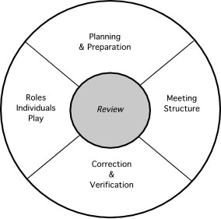
Reference Model
Unit 7

Slide 37
Informal Reviews
Informal reviews include:
a simple desk check of a software engineering work product with a colleague
a casual meeting (involving more than 2 people) for the purpose of reviewing a work product, or
the review-oriented aspects of pair programming
pair programming encourages continuous review as a work product (design or code) is created.
The benefit is immediate discovery of errors and better work product quality as a consequence.
Unit 7

Slide 38
Formal Technical Reviews
The objectives of an FTR are:
to uncover errors in function, logic, or implementation for any representation of the software
to verify that the software under review meets its requirements
to ensure that the software has been represented according to predefined standards
to achieve software that is developed in a uniform manner
to make projects more manageable
The FTR is actually a class of reviews that includes walkthroughs and inspections.
Unit 7

Slide 39
The Review Meeting
Between three and five people (typically) should be involved in the review.
Advance preparation should occur but should require no more than two hours of work for each person.
The duration of the review meeting should be less than two hours.
Focus is on a work product (e.g., a portion of a requirements model, a detailed component design, source code for a component)
Unit 7

Slide 40
The Players
review
leader
standards bearer (SQA)
producer
maintenance
oracle
recorder
reviewer
user rep
Unit 7

Slide 41
The Players
Producer—the individual who has developed the work product
informs the project leader that the work product is complete and that a review is required
Review leader—evaluates the product for readiness, generates copies of product materials, and distributes them to two or three reviewers for advance preparation.
Reviewer(s)—expected to spend between one and two hours reviewing the product, making notes, and otherwise becoming familiar with the work.
Recorder—reviewer who records (in writing) all important issues raised during the review.
Unit 7

Slide 42
Conducting the Review
Review the product, not the producer.
Set an agenda and maintain it.
Limit debate and rebuttal.
Enunciate problem areas, but don't attempt to solve every problem noted.
Take written notes.
Limit the number of participants and insist upon advance preparation.
Develop a checklist for each product that is likely to be reviewed.
Allocate resources and schedule time for FTRs.
Conduct meaningful training for all reviewers.
Review your early reviews.
Unit 7

Slide 43
Software Reliability
A simple measure of reliability is mean-time-between-failure (MTBF), where
MTBF = MTTF + MTTR
The acronyms MTTF and MTTR are mean-time-to-failure and mean-time-to-repair, respectively.
Software availability is the probability that a program is operating according to requirements at a given point in time and is defined as
Availability = [MTTF/(MTTF + MTTR)] x 100%
Unit 7

Slide 44
Software Safety
Software safety is a software quality assurance activity that focuses on the identification and assessment of potential hazards that may affect software negatively and cause an entire system to fail.
If hazards can be identified early in the software process, software design features can be specified that will either eliminate or control potential hazards.
Unit 7

Slide 45
Six-Sigma for Software Engineering
The term “six sigma” is derived from six standard deviations—3.4 instances (defects) per million occurrences—implying an extremely high quality standard.
The Six Sigma methodology defines three core steps:
Define customer requirements and deliverables and project goals via well-defined methods of customer communication
Measure the existing process and its output to determine current quality performance (collect defect metrics)
Analyze defect metrics and determine the vital few causes.
Improve the process by eliminating the root causes of defects.
Control the process to ensure that future work does not reintroduce the causes of defects.
Unit 7

Slide 46
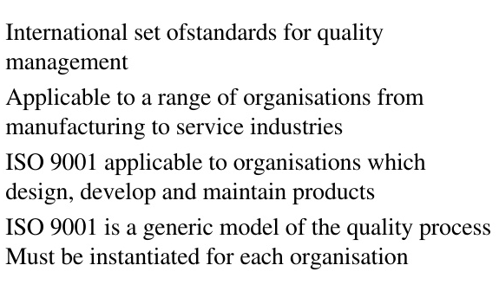
ISO 9000
Unit 7

Slide 47
ISO 9001:2000 Standard
ISO 9001:2000 is the quality assurance standard that applies to software engineering.
The standard contains 20 requirements that must be present for an effective quality assurance system.
The requirements delineated by ISO 9001:2000 address topics such as
management responsibility, quality system, contract review, design control, document and data control, product identification and traceability, process control, inspection and testing, corrective and preventive action, control of quality records, internal quality audits, training, servicing, and statistical techniques.
Unit 7

Slide 48
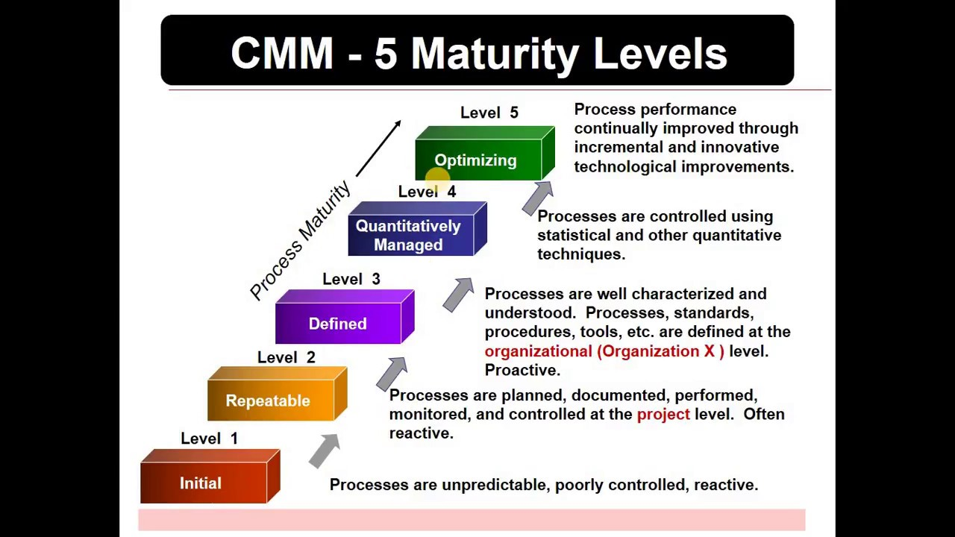
Capability Maturity Model (CMM)
Unit 7

Slide 49
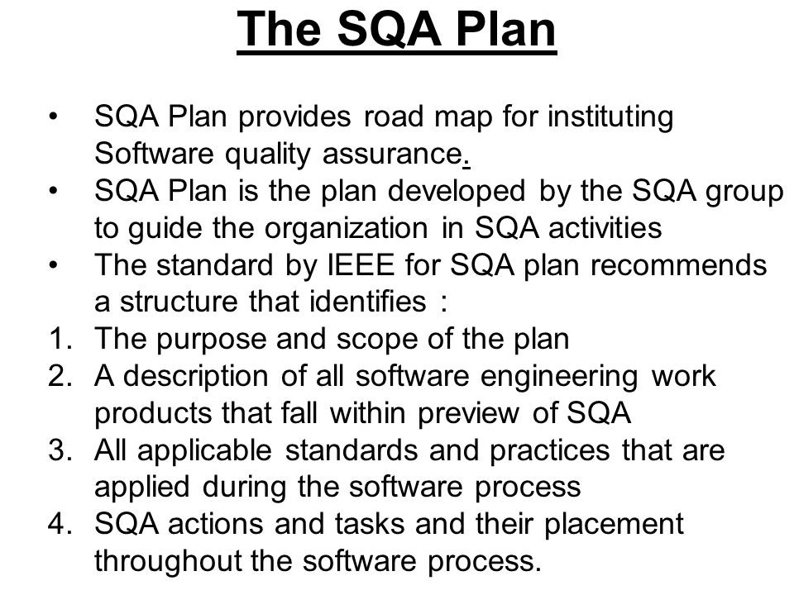
Unit 7

Slide 50
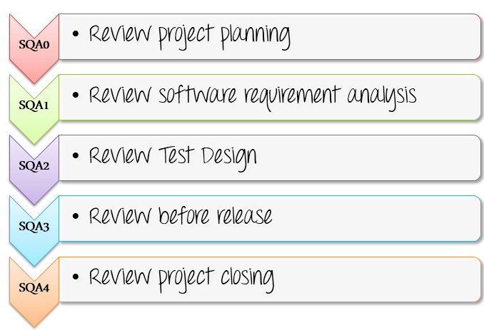
Unit 7

Slide 51


